Slide 1


Anomaly detection of heartbeats using their generated graphs
March 2020
Università della Svizzera italiana
Amirehsan Davoodi
Supervisors: Cesare Alippi - Daniele Zambon

Slide 2
Contents
Quick recap
Signal processing analysis
Detect heartbeat
Generate graphs for each heartbeat
Visibility graph
Horizontal visibility
Signed visibility graph
Learning on graph representation
Some confusions
Anomaly Detection vs Classification
Stationarity, Time-variance
Active learning
CDT on Graph streams (Daniele Zambon Paper)
Learning Graph Embedding on CCM
Questions
Advices

Slide 3

Quick recap

Slide 4
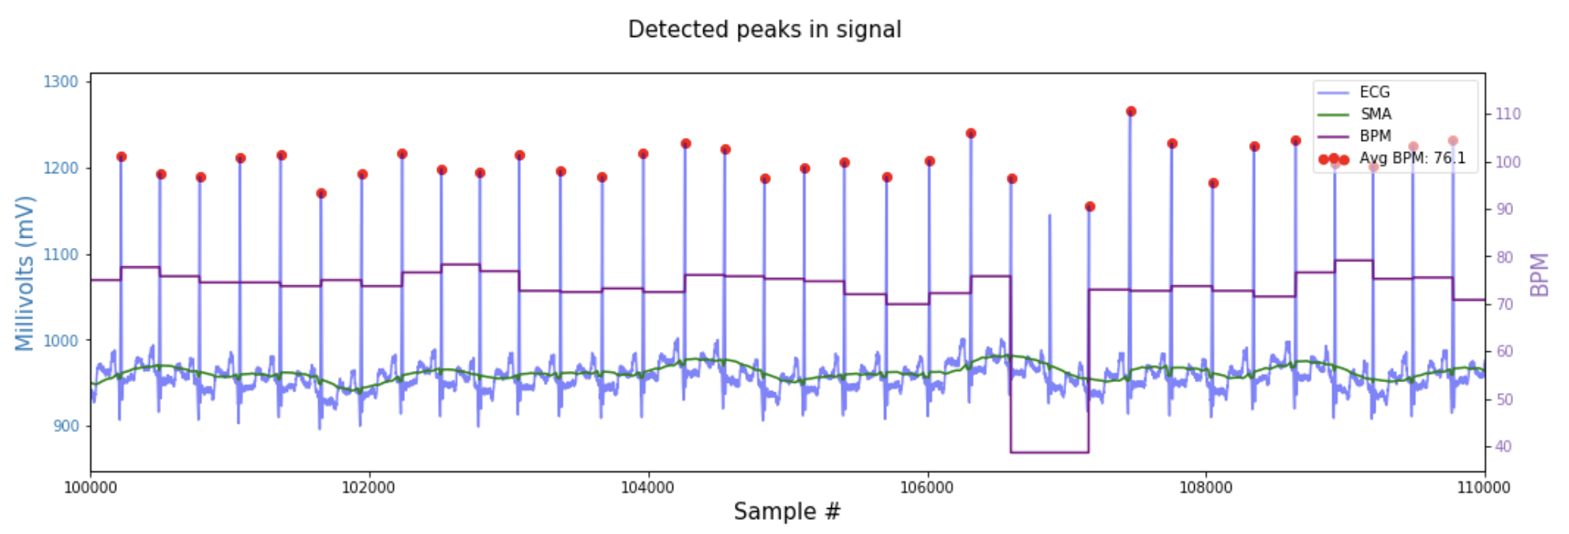
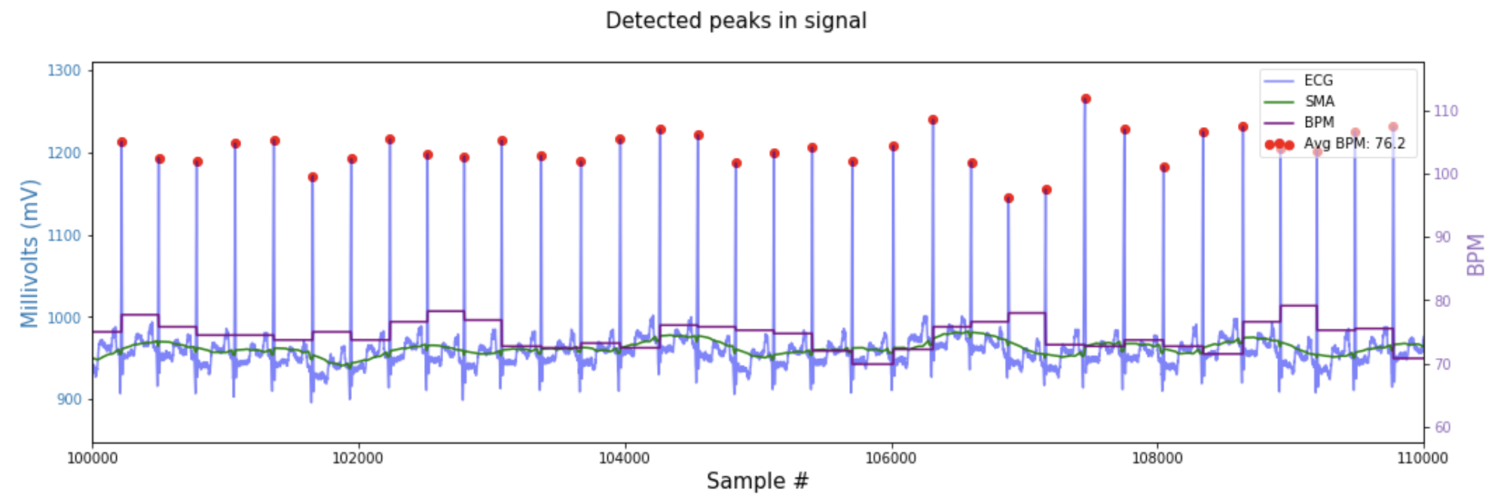
Signal processing analysis:
Moving average
Beat Per minutes
R-peak detection
Detect R-peaks better

Slide 5
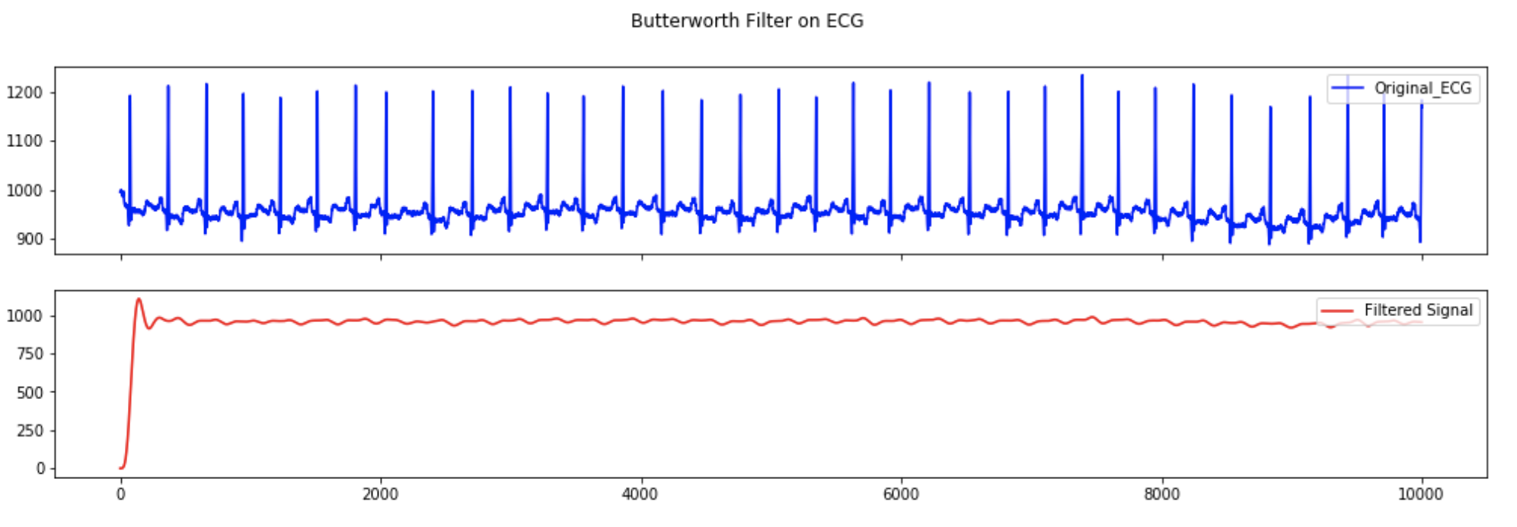

Signal processing analysis:
Apply filter on data
Butterworth Filter

Slide 6
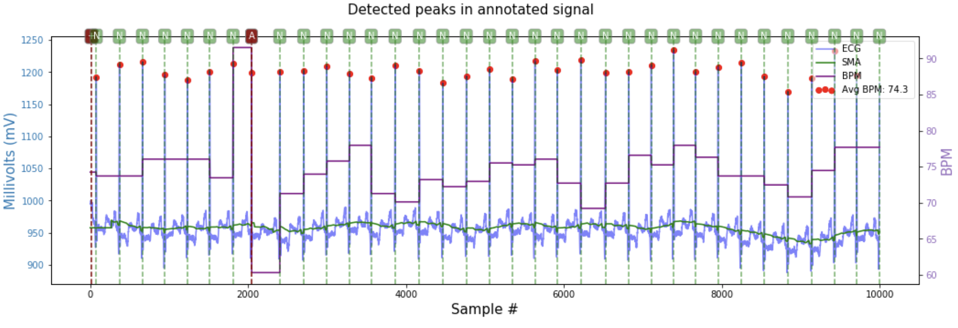

Signal processing analysis:
Annotated analyzed signal

Slide 7
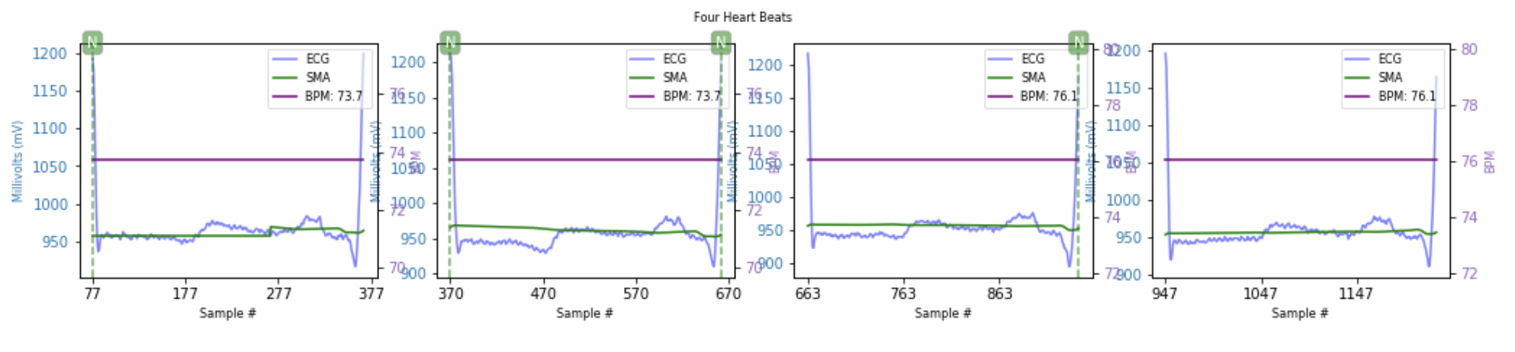

Detect heartbeats
using only R-peaks
total number of Heartbeats for 30 minutes record = 2272

Slide 8

Graph Generation

Slide 9
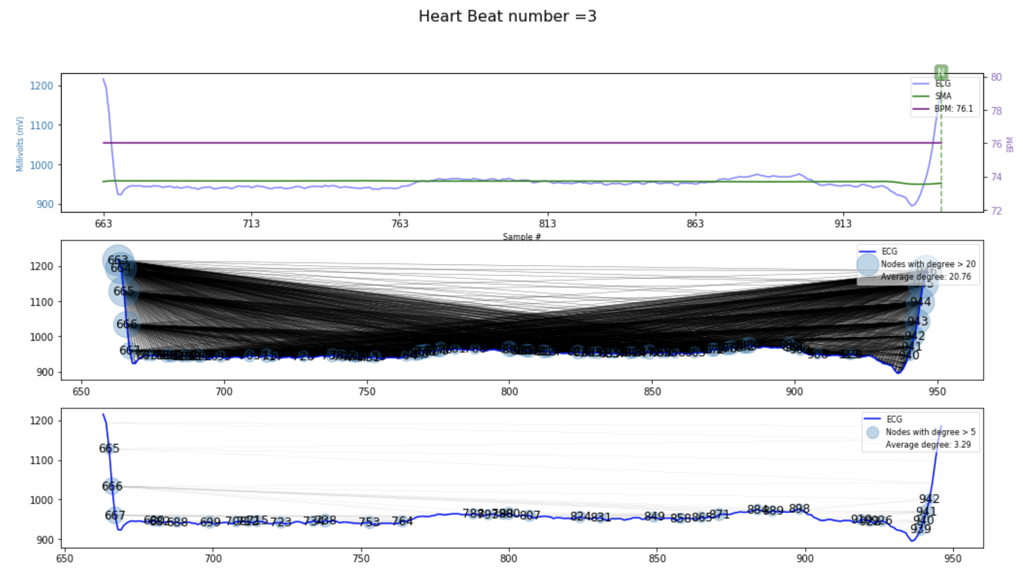
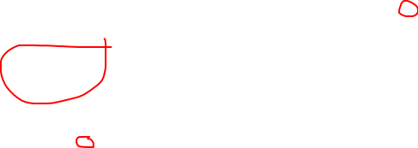
Generate graph for each heartbeat
Analyzed Signal
Moving average
Beat Per minutes
R-peak detection
Only showing nodes with degree > 20
Visibility graph
Number of nodes: 284 Number of edges: 2948 Average degree: 20.76
Only showing nodes with degree > 5
Horizontal Visibility graph
Number of nodes: 284 Number of edges: 467 Average degree: 3.29

Slide 10
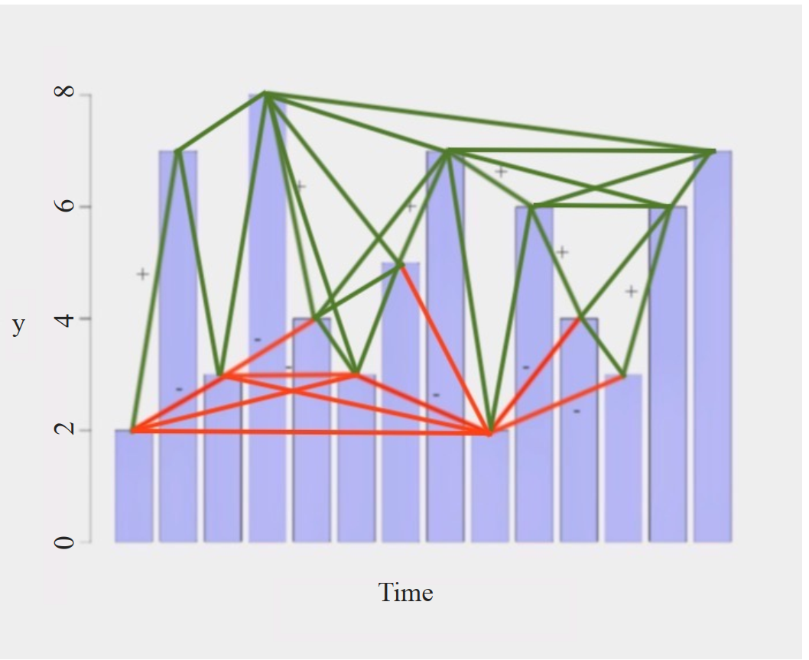

Signed Visibility graph
Positive visibility graph
(Green)
Negative visibility graph
(Red)

Slide 11
Learning on graph representation

Slide 12
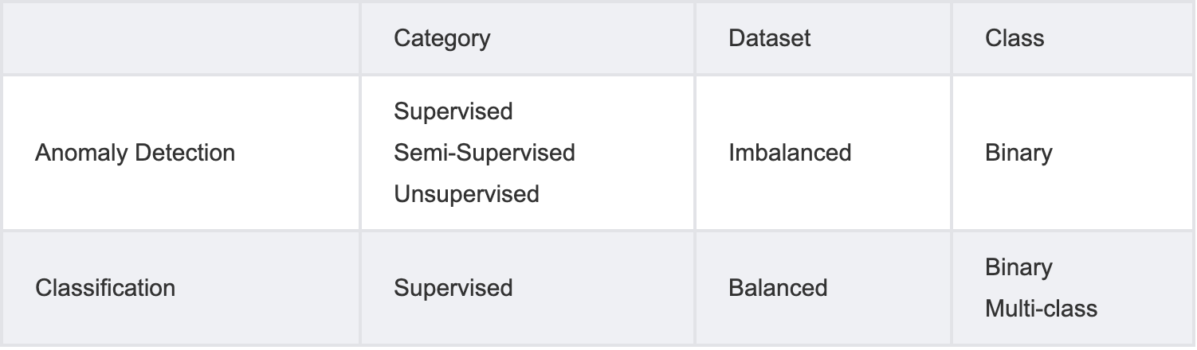
Anomaly Detection vs Classification

Slide 13

Stationary time-variance
In Graph domain
In Graph domain
Each heartbeat graph is i.i.d. variable and their distribution does not change over time.
A system is said to be time variance if it’s input, output characteristics changes with time.
?

Slide 14
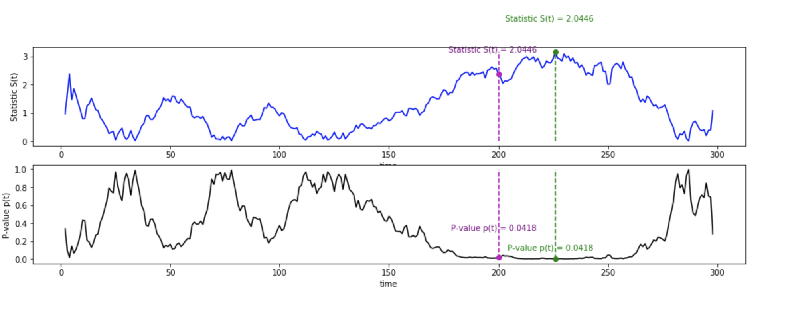
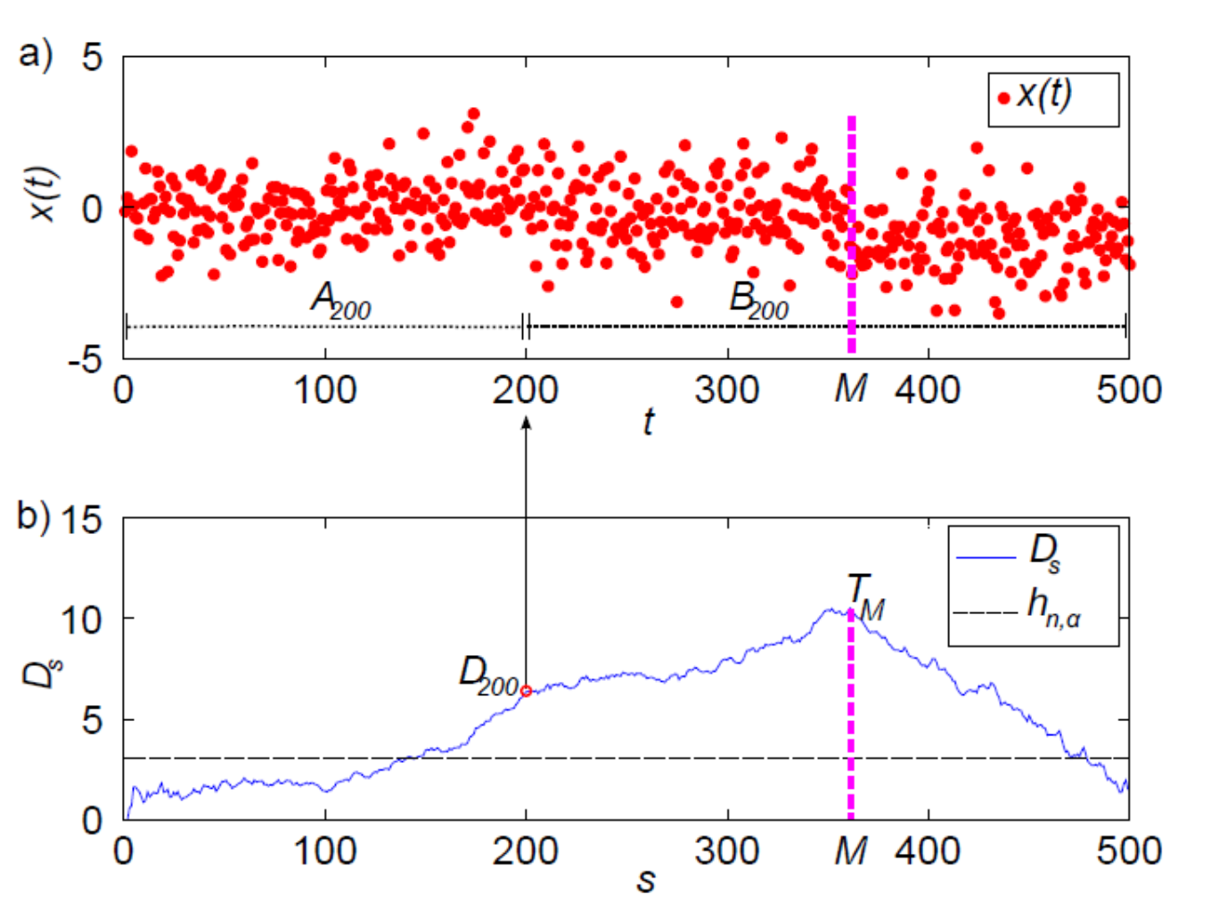

Active learning
The oracle provides information about the change to trigger the learning (retrain at the time of detecting change)
In sequential active learning we call it Concept drift
Change Detection Test (CDT) - online
Change Point Method (CPM) - offline
In my case, I only want to find the point anomaly not the time of change.
?

Slide 15

CDT on Graph streams
Steps:
Embed graph to vector domain
Using dissimilarity (Graph Edit Distance)
Using some prototype graphs (K-Centre method) ???
CDT on multivariate vector stream
Apply a variation of CUSUM test ???
On the experiments (Letter, Mutagenicity and AIDS dataset), you first sorted the nominal and non-nominal graphs into two group then find the exact time of change which I think is not useful for my problem
?

Slide 16
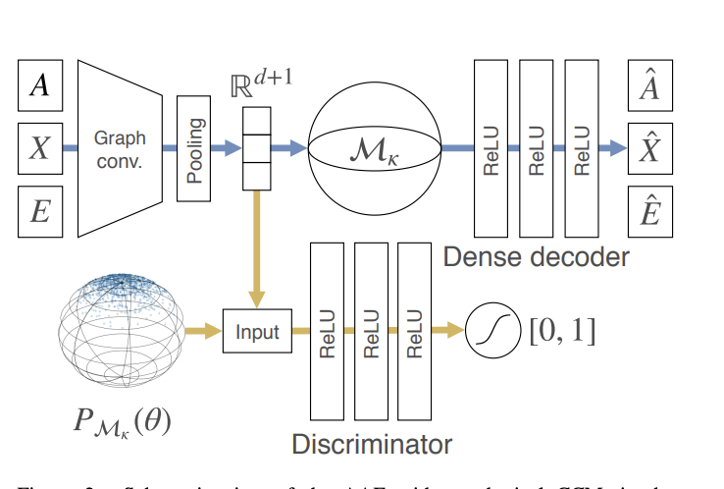
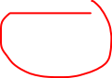
Learning Graph Embedding on CCM
Steps:
Embed graph to vector domain
Using Graph Autoencoder
CDT on multivariate vector stream
Apply a variation of CUSUM test ???
Didn’t understanding it should I put more time.

Slide 17
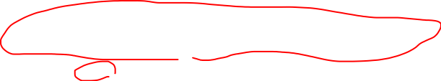
Questions
Change point methods (CPM) on a sequence of graphs I need online but having sliding window can work for offline?
One-class classifier consider the stream of graphs with no specific presentation order. Do I really need to consider the order?
How in CDT the order maters if I only use it to detect point anomaly?
Anomaly

Slide 18
Thanks ☺

